Slide 1



Control and Automation IC2122 Robotics Lab with VREP
Instructor:
Industrial Centre
The Hong Kong Polytechnic University

Slide 2
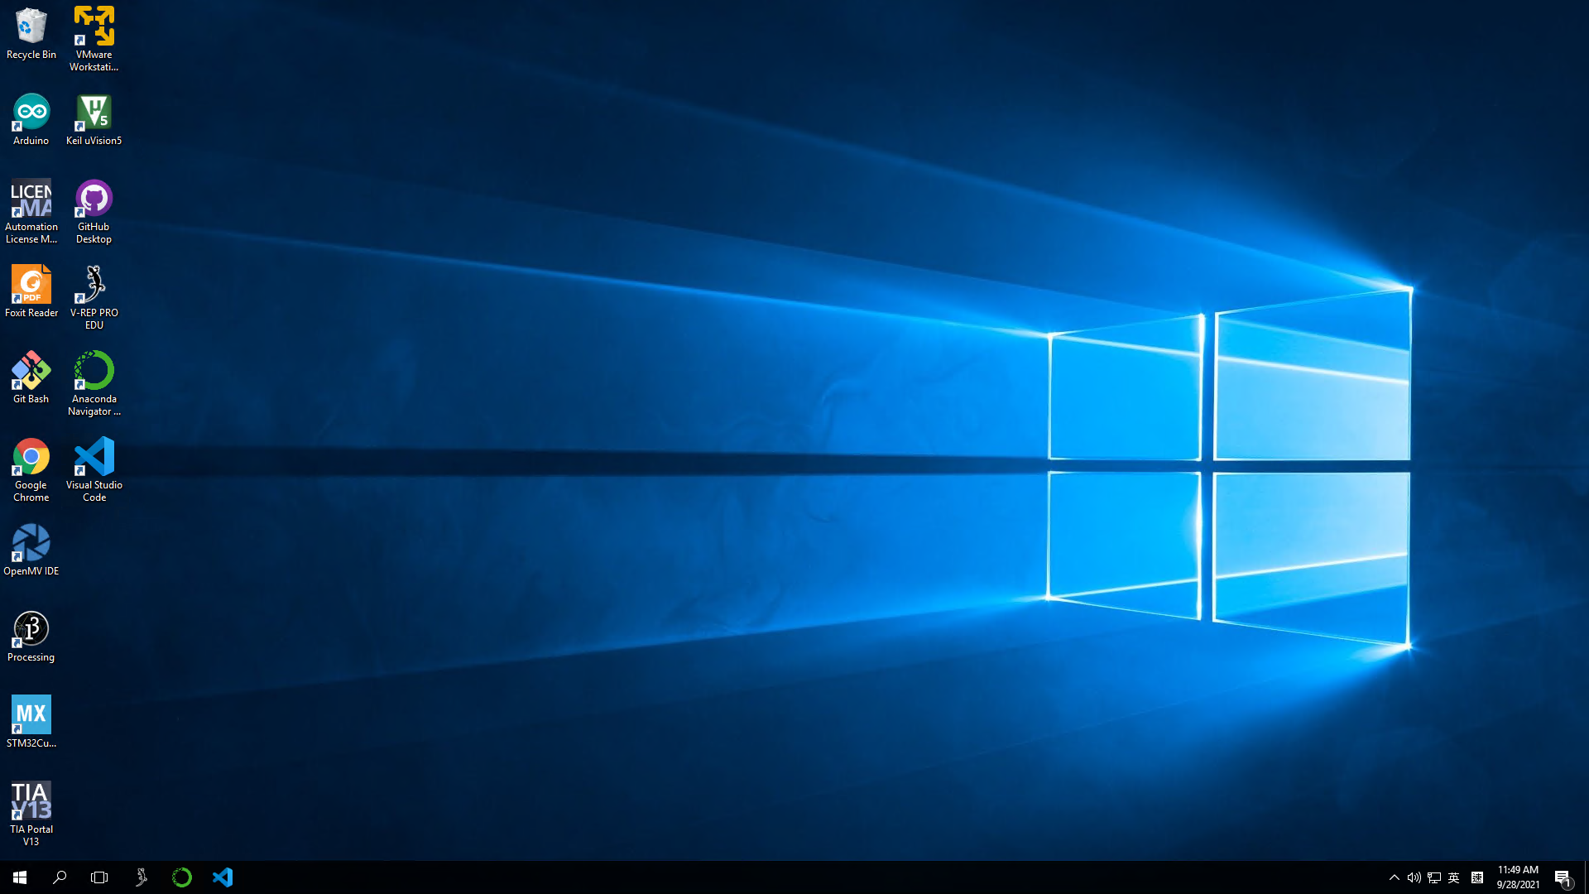

Software platform
V-REP
Simulation platform
Anaconda
Python distribution platform

Slide 3
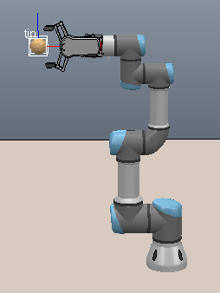
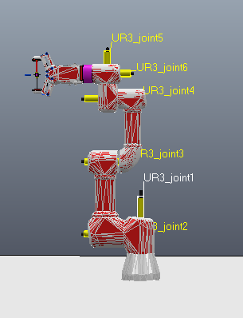
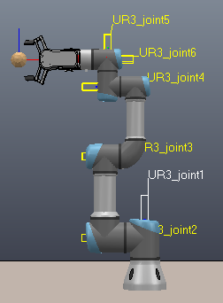
V-REP UR3
Joints (UR3):
From UR3_joint1 to UR3_joint6
End-effector (Tip):

Slide 4
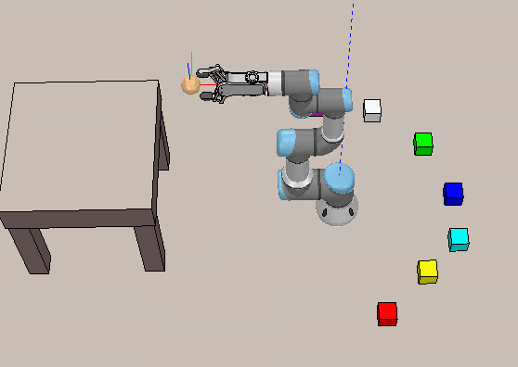
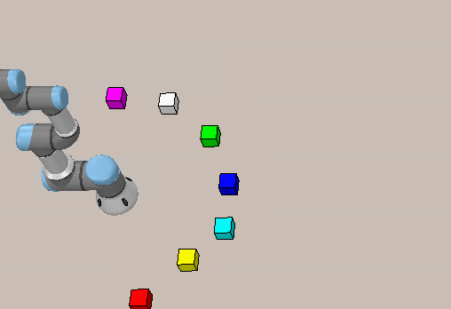

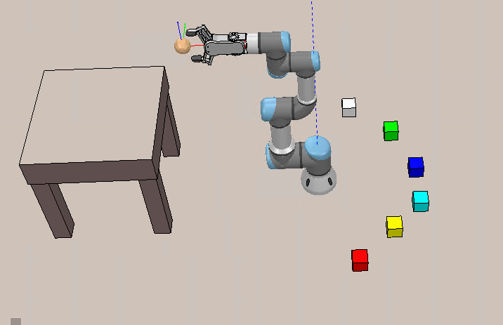
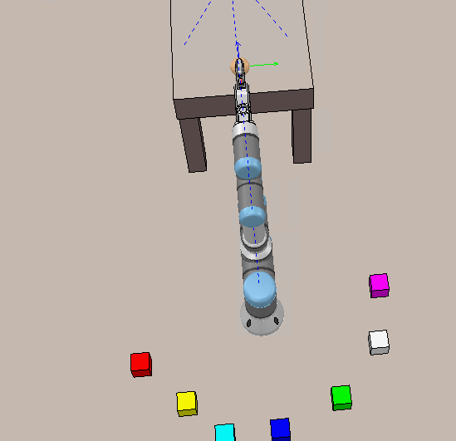


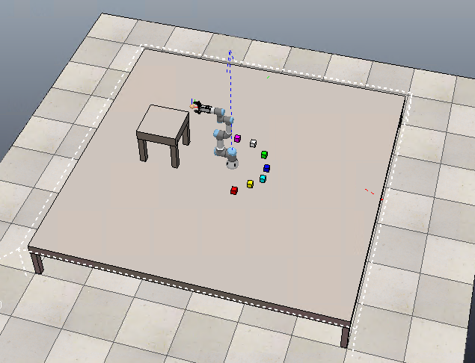
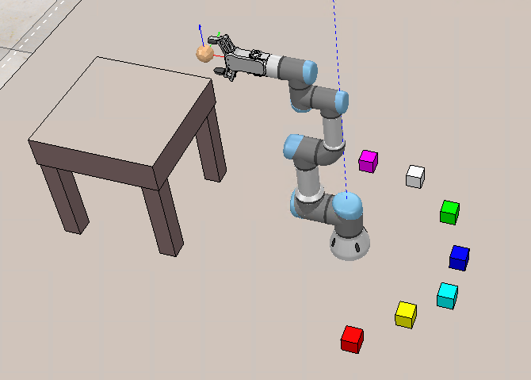
V-REP Tools
Camera Pan:
Moving the camera
Camera Rotate:
Rotating the camera
Camera Shift:
Zoom in or Zoom out

Slide 5
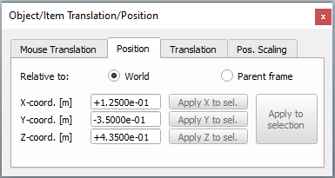
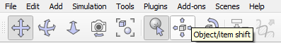
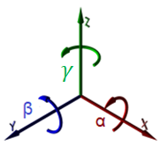
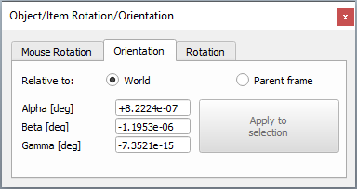
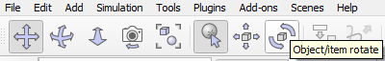
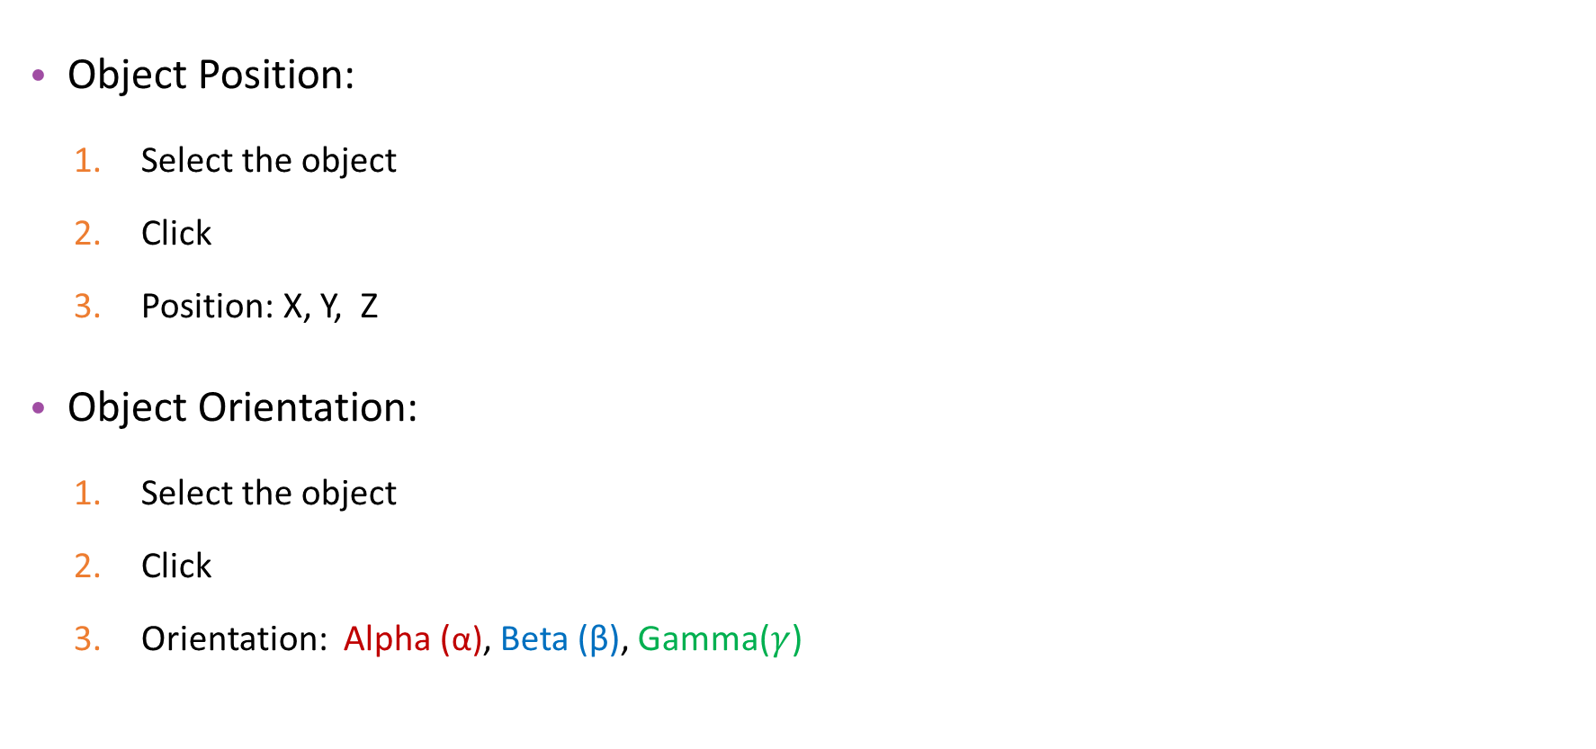
V-REP Tools
Object Position:
Select the object
Click
Position: X, Y, Z
Object Orientation:
Select the object
Click
Orientation: Alpha (α), Beta (β), Gamma($γ$)

Slide 6
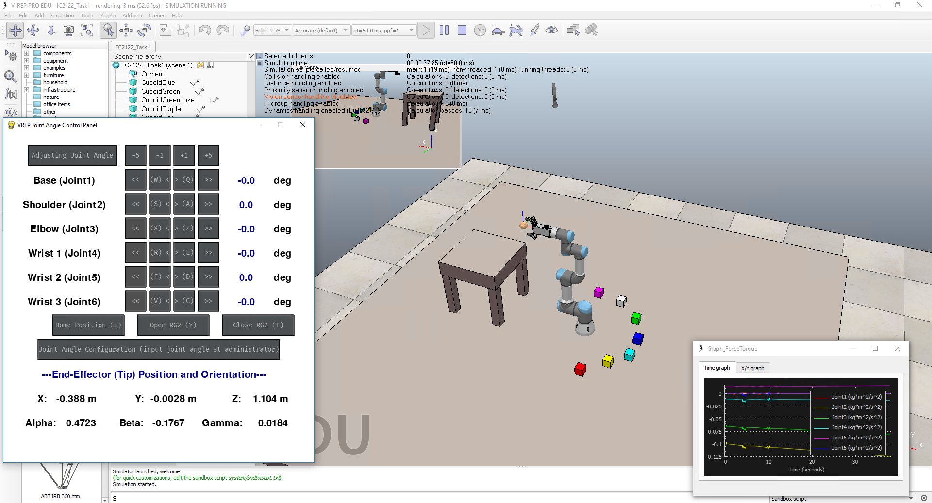
Task 1: Forward Kinematics

Slide 7
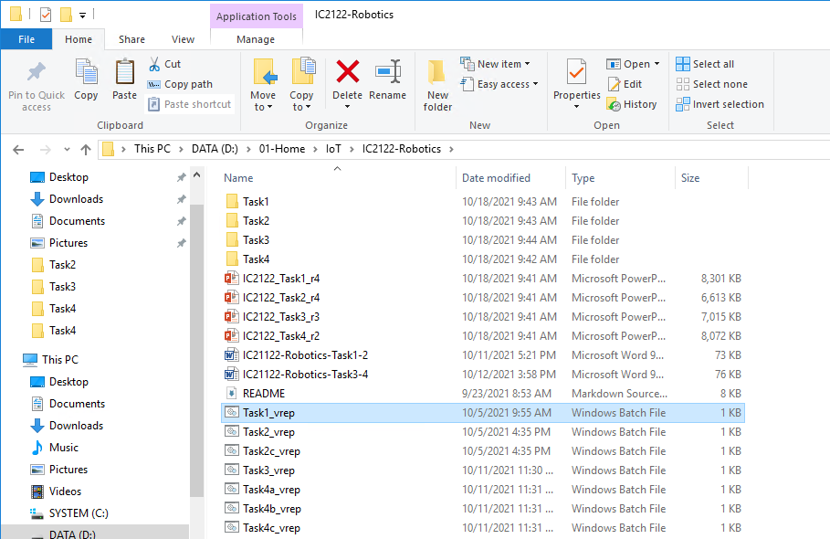
Start-up – V-REP
Start the V-REP (Task1_vrep.bat)
D:\01-Home\IoT\IC2122-Robotics
Double-Click

Slide 8
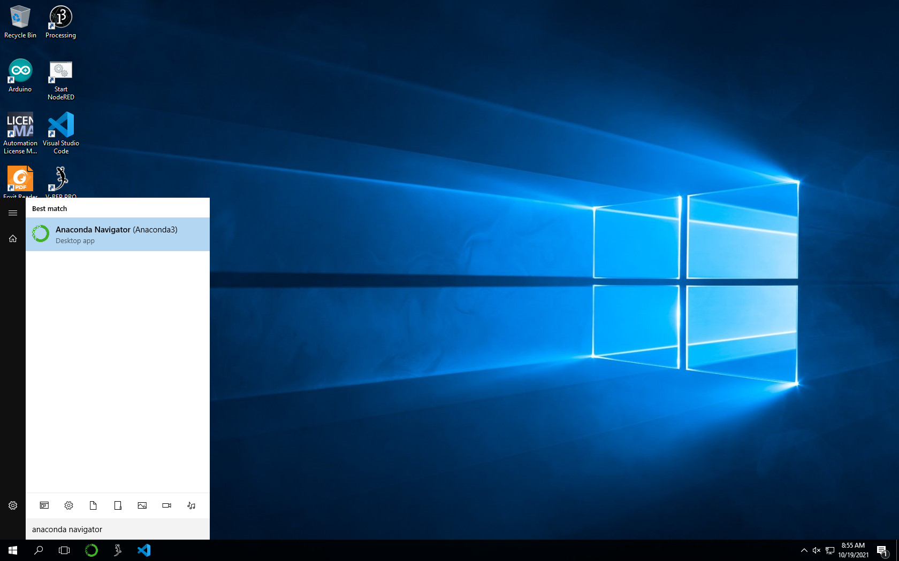
Start-up – Anaconda Navigator
Start the Anaconda Navigator on Taskbar or search Windows
Search Anaconda Navigator and click the icon
OR
Click Anaconda Icon

Slide 9
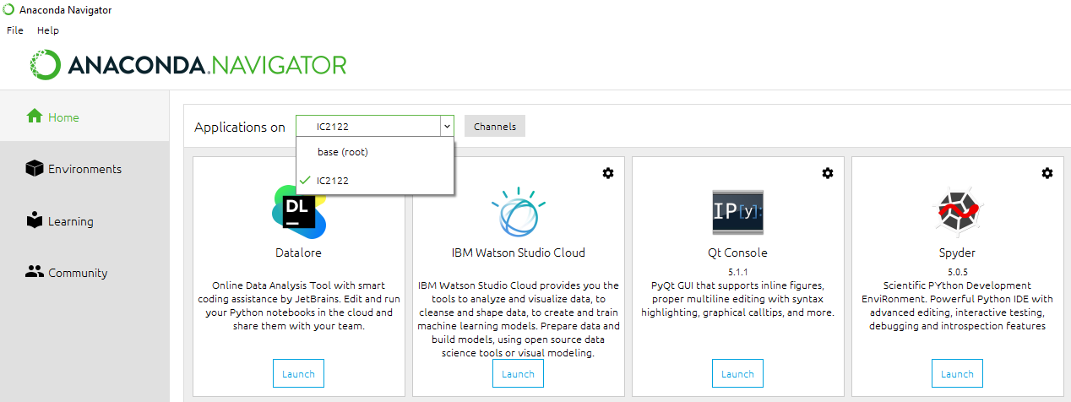
Start-up – Spyder
Launch Spyder
2
1
3
4

Slide 10
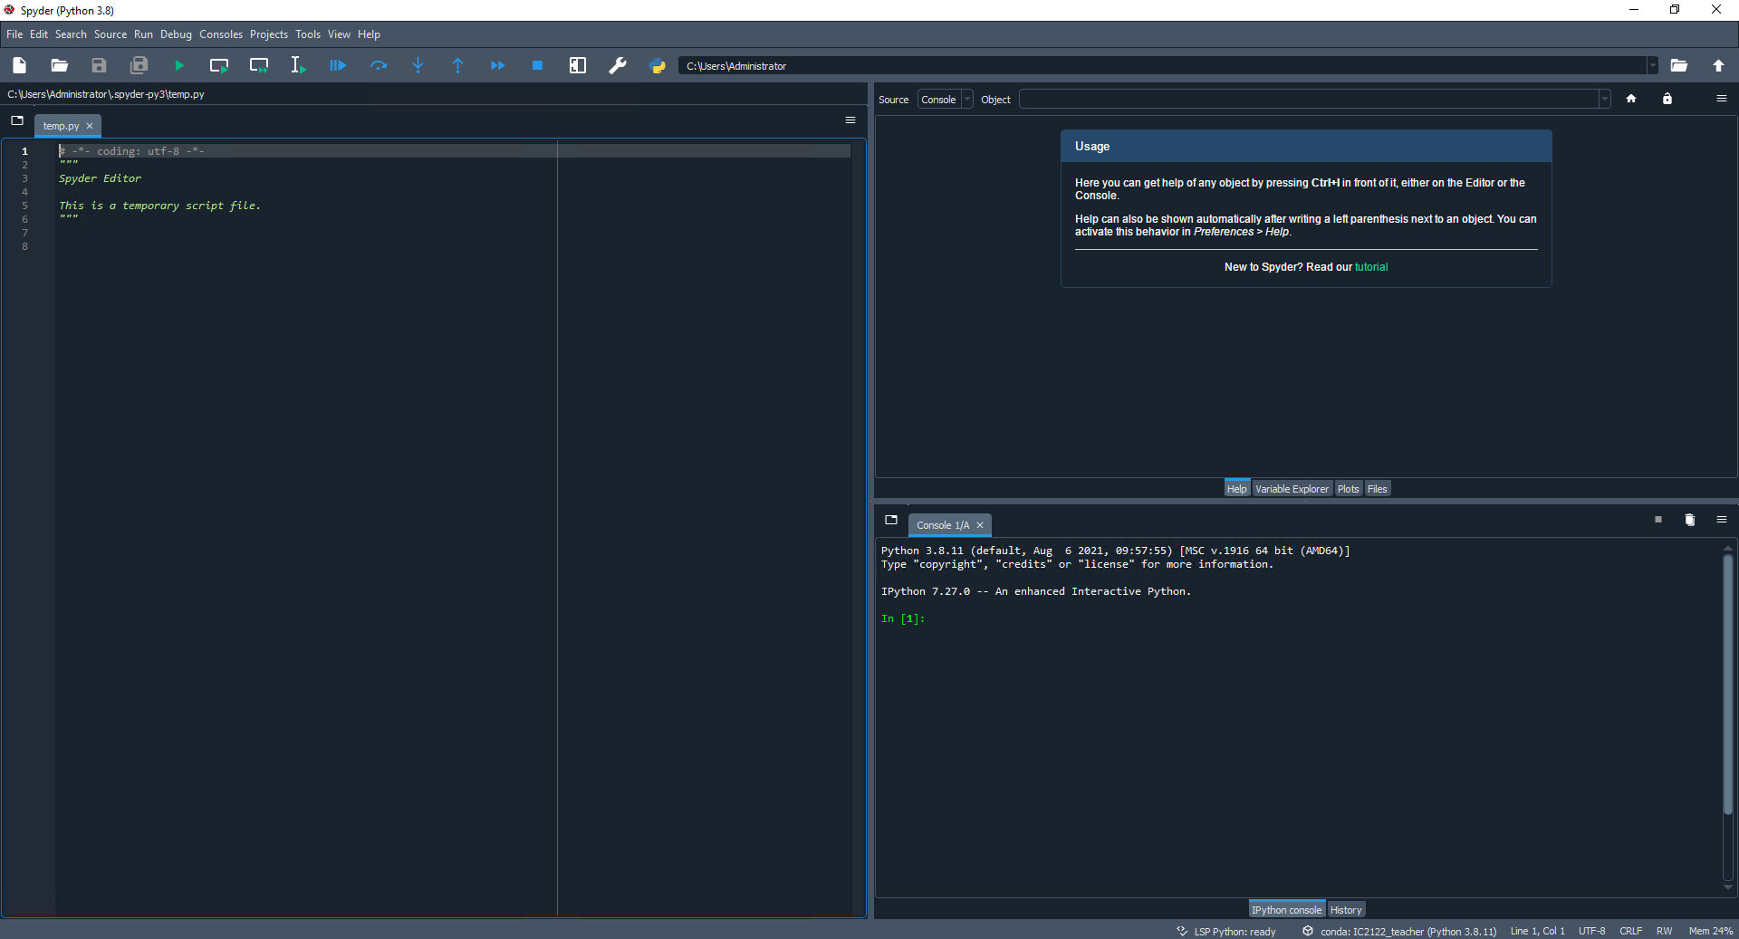
Start-up – Spyder
Toolbar
Help
Editor
IPython Console
Status Bar

Slide 11
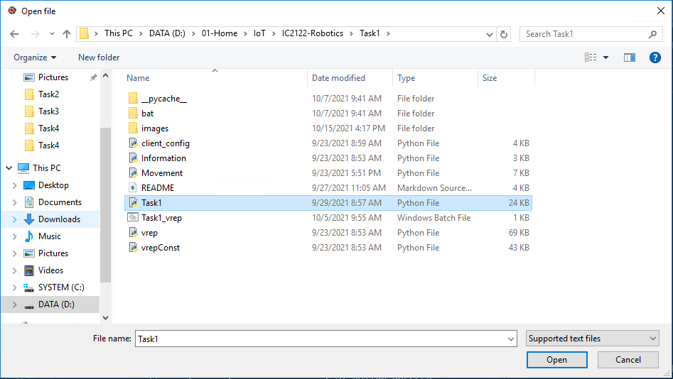
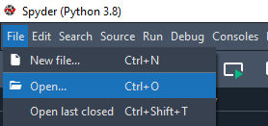
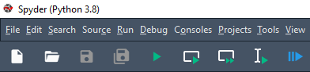
Start-up – Spyder
D:\01-Home\IoT\IC2122-Robotics\Task1
Open Python file at editor
Run the program at Spyder
3
1
2
4
5
6

Slide 12
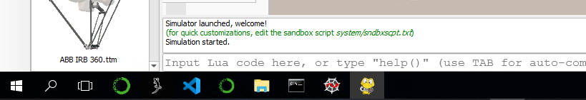
Start-up – Control panel window
Control panel window will be appeared after running the program
After switching to the V-REP, the control panel window will be hidden
Click the Control panel window icon to open it.
Click this icon

Slide 13
Start-up
V-REP interface :

Slide 14
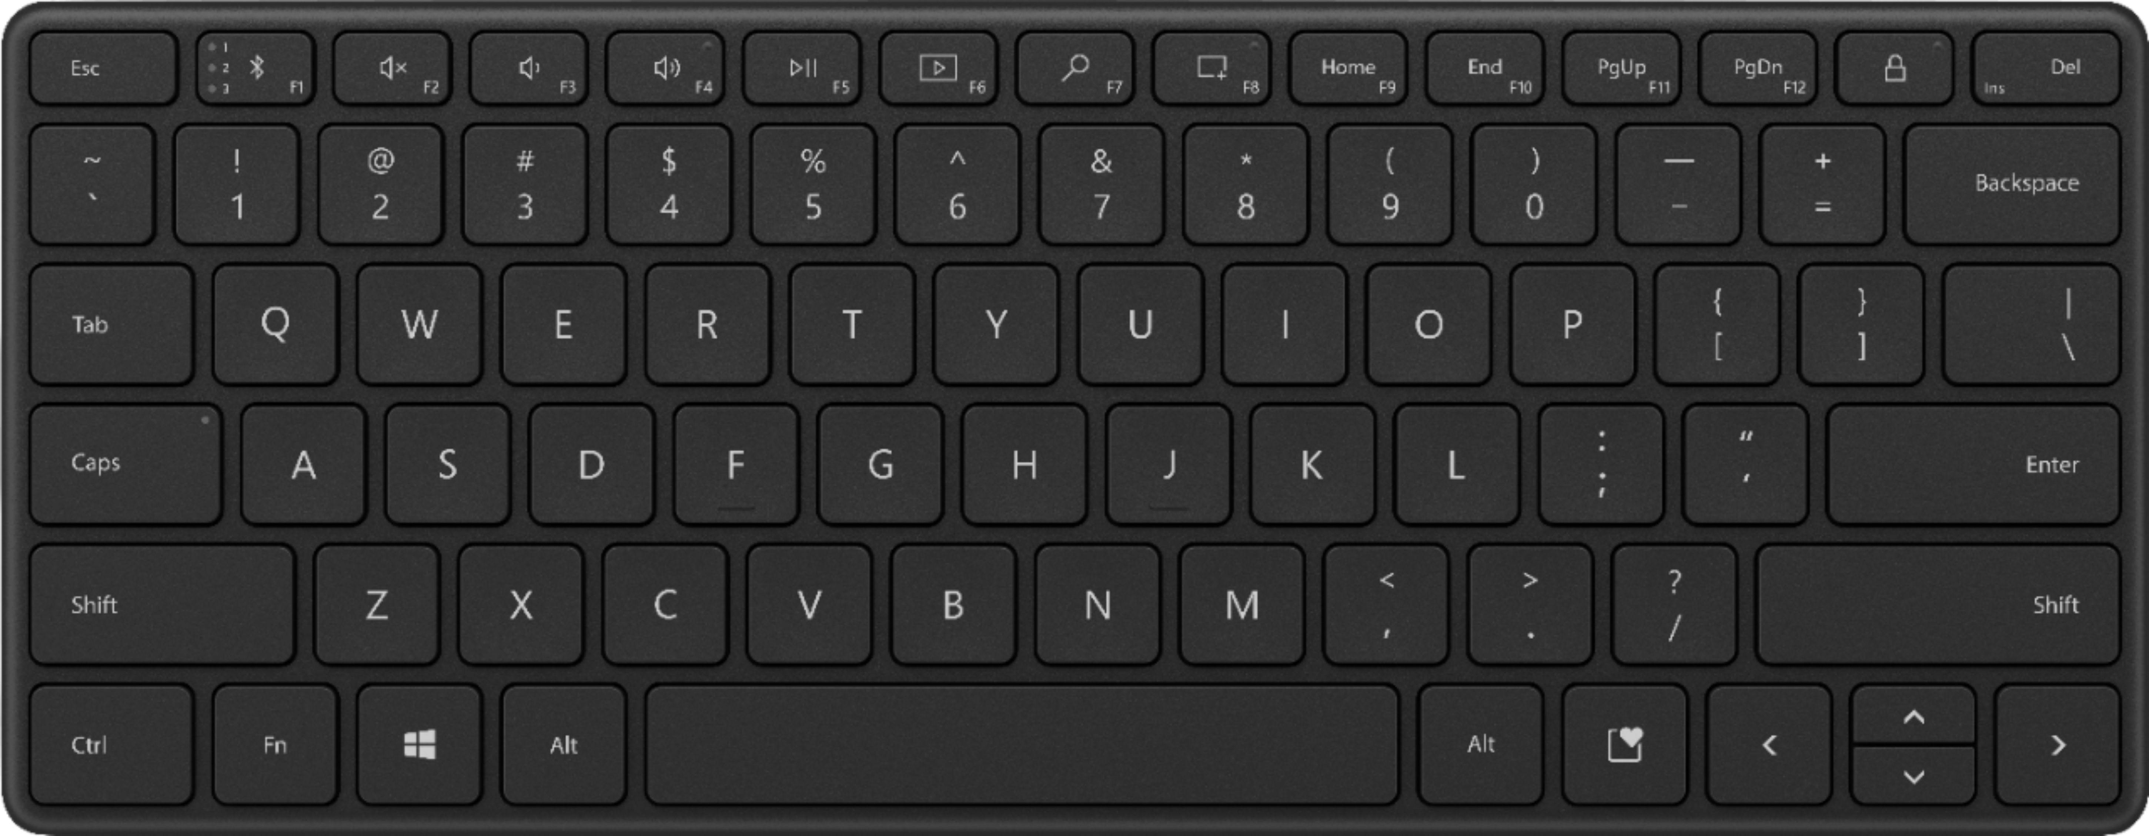
V-REP Joint Angle - Keyboard Control
Joint Movement ( +/- 1 degree)
Pose:
(L): Return Pose
Return all of the joint angles as 0 degrees
Gripper (RG2):
(Y): Close RG2
Grip object
(T): Open RG2
Release object
Joint Name | Keyboard
 | -1 degree | +1 degree
Joint 1 | (W) | (Q)
Joint 2 | (S) | (A)
Joint 3 | (X) | (Z)
Joint 4 | (R) | (E)
Joint 5 | (F) | (D)
Joint 6 | (V) | (C)

Slide 15
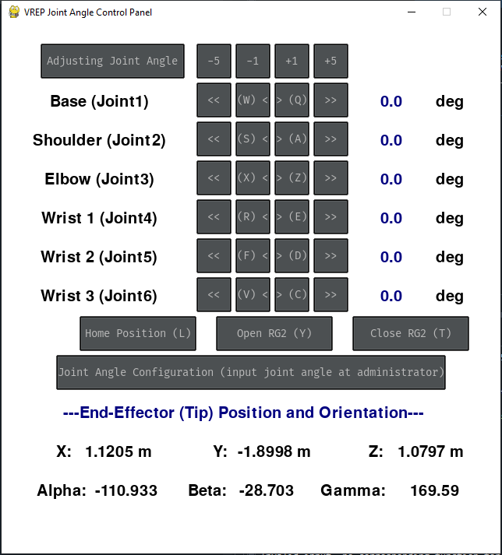
V-REP Joint Angle - Control Panel
Joint Name
Joint Angle
End-effector Position
End-effector Orientation

Slide 16
V-REP Joint Angle - Control Panel
Joint Angle Movement:
- 5 degrees of Joint angle
- 1 degrees of Joint angle
+ 1 degrees of Joint angle
+ 5 degrees of Joint angle
Return Pose:
Return all of the joint angles as 0 degrees

Slide 17
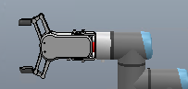
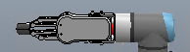

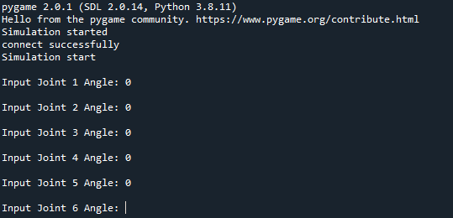
V-REP Joint Angle - Control Panel
Gripper (RG2):
Close RG2 to Grip object
Open RG2 to Release object
Joint Angle Configuration
Set all of the joint angles in the IPython Console
(Input value and press enter
at Spyder IPython Console )
Input your value

Slide 18
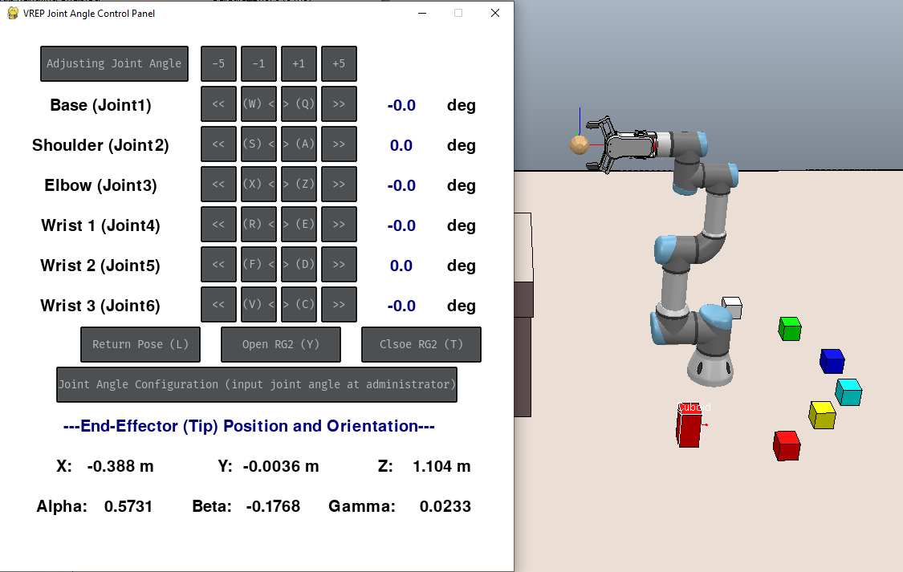
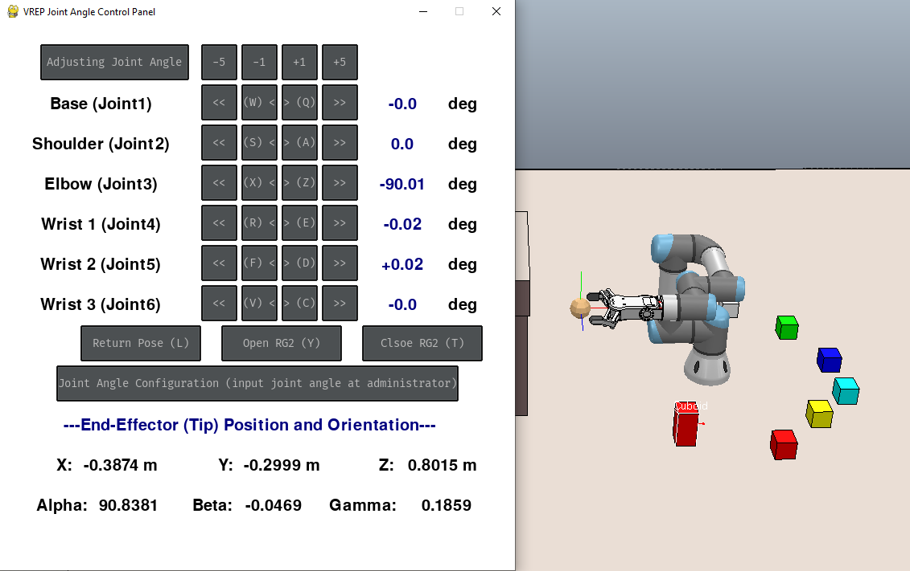
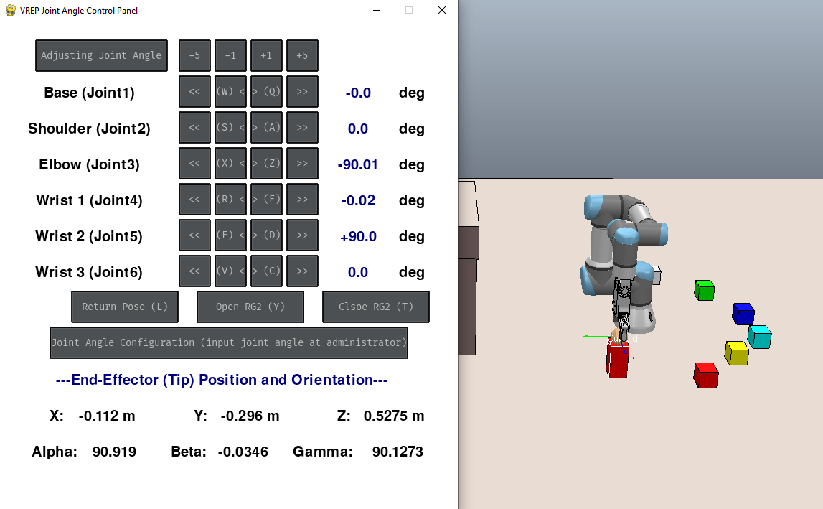
V-REP Joint Angle – Example 1
Example 1: Move the end-effector on top of the RED rectangle.
Steps:
Switch to the “V-REP Control Panel” window and observe the UR3’s movement when clicking the button to adjust joint angle (synchronizing with V-REP)
Tune Joint 3 angle as -90 degree
(Press "X" or click button "<" / "<<" to adjust)
Tune Joint 5 angle as +90 degree
(Press "D" or click button ">" / ">>" to adjust)
Home position

Slide 19
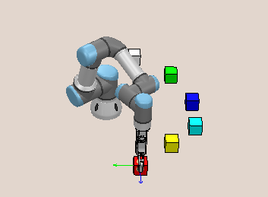
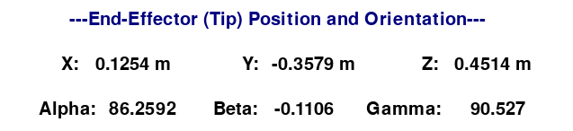
IC2122 – Task 1a
Task 1a: Move the end-effector to the RED block using Forward Kinematics
and write down the joint angles.
Red Block Position: | Position X | Position Y | Position Z
 | 0.125 m | -0.35 m | 0.435 m
Final Goal
End-effector information

Slide 20
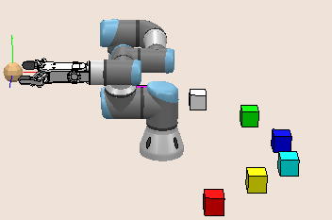
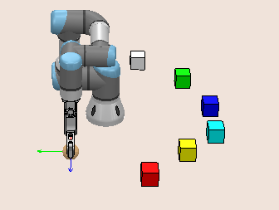
IC2122 – Task 1a (Hints)
Task 1a: Move the end-effector to the RED block using Forward Kinematics and write down the joint angles.
(Hints: Adjust the joint angles one by one)
Step 1: Adjust two joint angles
Make the RG2 parallel to the table
Step 2: Adjust one joint angle
Make the end-effector vertically to the ground
Step 1
Step 2

Slide 21

IC2122 – Task 1a (Hints)
Task 1a: Move the end-effector to the RED block using Forward Kinematics and write down the joint angles.
(Hints: Adjust the joint angles one by one)
Step 3: Adjust the joint angles to reach the RED block
(End-effector’s position ≈ Red block’s position)
Final Goal

Slide 22
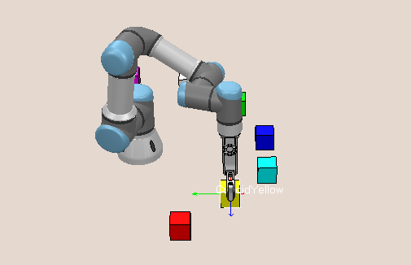
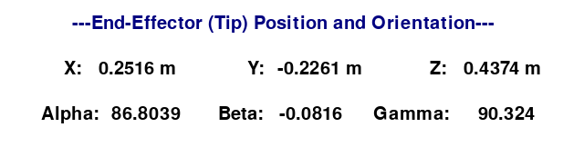
IC2122 – Task 1b
Task 1b: Move the end-effector to the YELLOW block using Forward Kinematics and write down the joint angles.
(Remark: end-effector should be located inside the YELLOW block)
Yellow Block Position: | Position X | Position Y | Position Z
 | 0.25 m | -0.225 m | 0.435 m
Final Goal
End-effector information

Slide 23
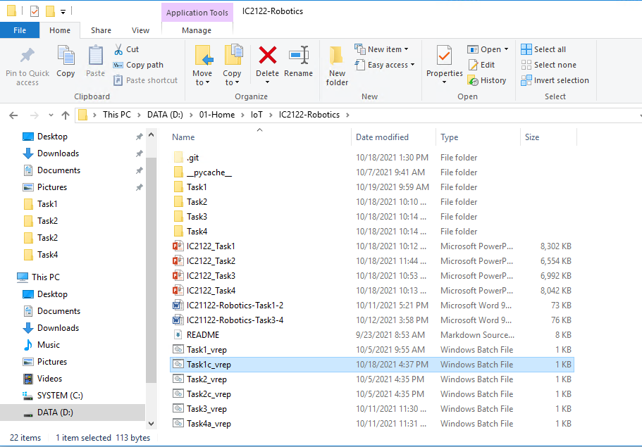
IC2122 – Task 1c
Stop the program by holding “Ctrl” and clicking “C” (IPython console)
Open a new console by holding “Ctrl” and clicking “D” (IPython console)
Close the previous V-REP
Start a new V-REP (Task1c_vrep.bat)
Run the Task1.py program (Spyder)
Double-Click

Slide 24
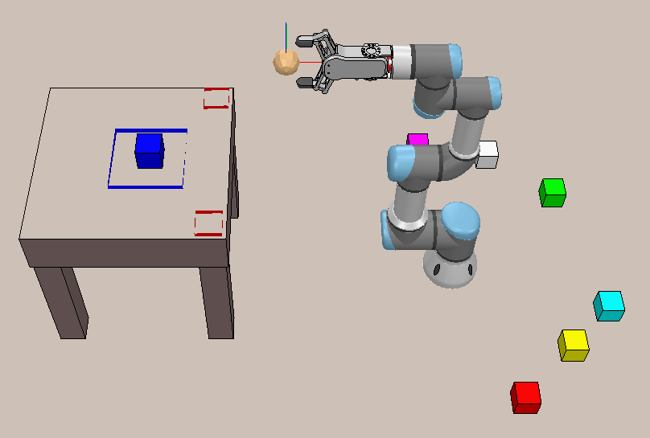
IC2122 – Task 1c
Task 1c: Place the BLUE block on the table (inside Blue colour area) using
Forward Kinematics and write down the procedure.
Final Goal
Blue Block original Position: | Position X | Position Y | Position Z
 | 0.35 m | 0.025m | 0.435 m
Blue Block final Position: | Position X | Position Y | Position Z
 | ≈ -0.667 m | ≈ 0 m | 0.846 m

Slide 25
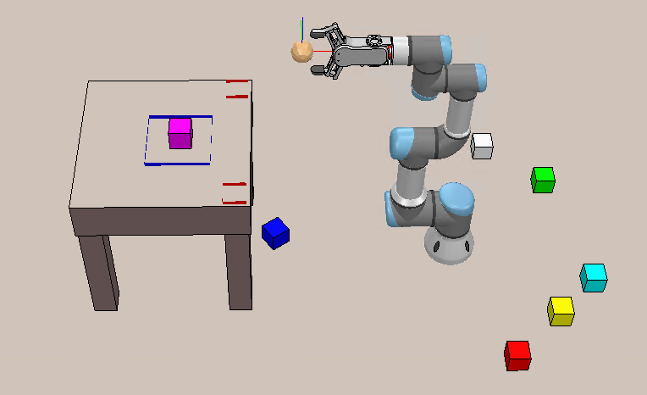
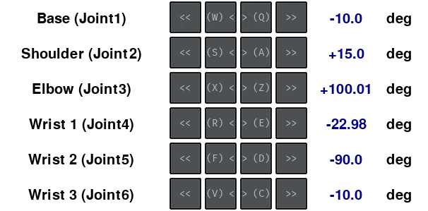
IC2122 – Task 1c
Second chance (Failed for picking and placing BLUE block)
Task 1c: Place the PURPLE block on the table (inside Blue colour area) using
Forward Kinematics and write down the procedure.
Arrive at PURPLE block:
Click “Home Position”
Click “Joint Angle Configuration” and
input the following value and press enter
Final Goal
PURPLE Block final Position: | Position X | Position Y | Position Z
 | ≈ -0.667 m | ≈ 0 m | 0.846 m

Slide 26
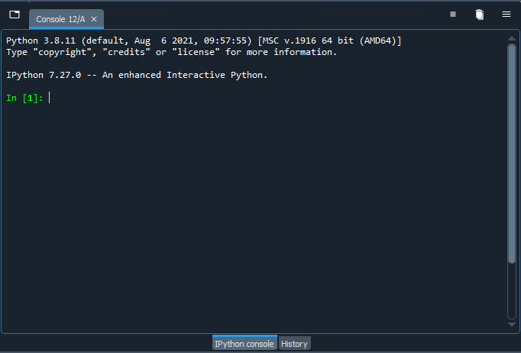
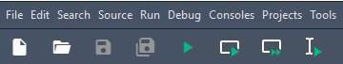
Task1 – Troubleshoot
Step 1: Switch to the Spyder IPython Console
Step 2: Stop the program by holding “Ctrl” and clicking “C”
Step 3: Open a new console by holding “Ctrl” and clicking “D”
Step 4: Stop the V-REP simulation
Step 5: Run the program at Spyder
Step 1
Step 3
Step 2
Step 4
Step 5

Slide 27
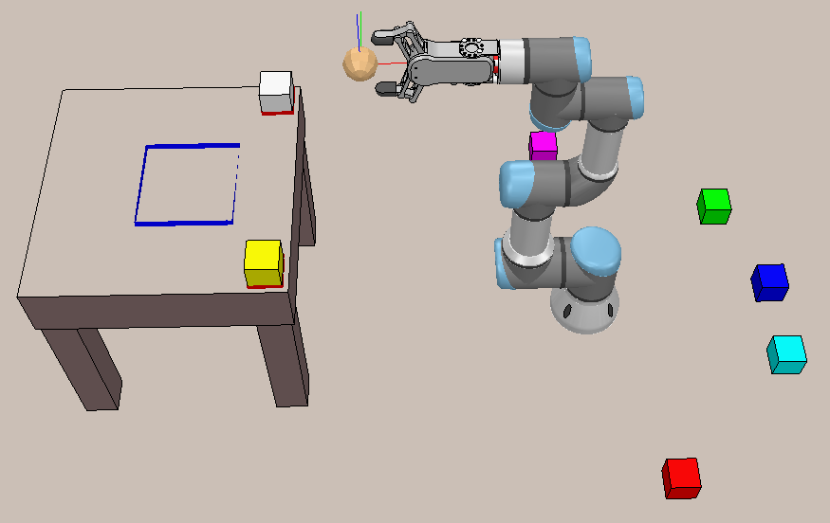
IC2122 – additional Task (optional)
Place the RED and WHITE block on the table (red colour area) using Forward Kinematics.
(Remark: The position and orientation should be same)
Final Goal
WHITE Block original Position: | Position X | Position Y | Position Z
 | 0.125 m | +0.325 m | 0.435 m
Yellow Block original Position: | Position X | Position Y | Position Z
 | 0.25 m | -0.225 m | 0.435 m
WHITE Block final Position: | Position X | Position Y | Position Z
 | -0.54 m | -0.165 m | 0.846 m
Yellow Block final Position: | Position X | Position Y | Position Z
 | -0.54 m | +0.165 m | 0.846 m

Slide 28
Q&A

